Slide 1
Title of Project
Presentation of project work
By:-
Name of student(roll no.)
Under guidance of :-
Name of guide
Designation of guide

Slide 2
Outlines
Introduction
Literature survey
Inferences drawn out of literature survey
Comparative analysis of existing systems
Problem statement
Solution approach
Real world application
Software and Hardware requirements
Modules and architectural description
Project progress status
References

Slide 3
Introduction
Font Size = 24
Justified and aligned content
Space only after new paragraph(more than one statements)
Minimum 3 maximum 5 slides.
Images should not be copied.
Above guidelines should be followed for all the slides

Slide 4
Literature Survey
Describe already existing similar type of application/ tool/web site/system.(at least 3 those have been studied)
Explain the method/technique used by already existing systems.
Describe the work already done with proper reference.
Functionality should incorporate the technology used in brief.
Minimum 3 maximum 5 slides.

Slide 5
Inferences Drawn Out of Literature Survey
Explain the findings in each system/application.
Findings can be pros and cons.
Minimum 3 maximum 5 slides.

Slide 6
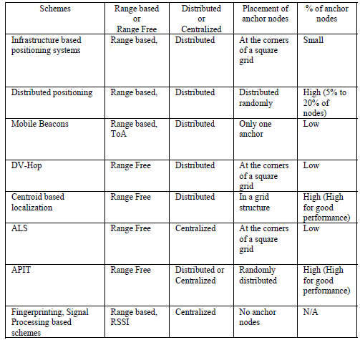
Comparative analysis existing system
A table of comparison should be given.
All the techniques should be compared on the basis of its essential properties.
Maximum 1 slide.
See example below (don’t use image make a table)

Slide 7
Problem Statement
Explain the shortcomings in already existing system.
Explain how these shortcomings will be upgraded by proposed project.
Explain what new project is proposing.
Minimum 2 maximum 4 slides.
Content should be precise enough to explain why actually this project have been opted.

Slide 8
Solution approach
Explain how the proposed problem will be solved.
What basic strategy will be taken to solve the stated problem.
Make the process flow diagram for solving the stated problem (See the next slide for example).
Write the assumptions if any to be taken to make the project live.
Minimum 2 maximum 4 slides.

Slide 9
Methodology
Least square method
Area localization method
DET broadcast beacon signal
Anchor node localized
Signal broadcast by anchor node
Ordinary node localized

Slide 10
Real world application
Explain what will be benefit of making this project.
Explain who will be intended user of this project.
Explain what short of real world a problem can be solved by this project.
Minimum 2 maximum 4 slides.

Slide 11
Software and Hardware requirements
Explain the Software and Hardware requirements in brief.
Front end and back end support if any.
Also explain reason for using these software.
If open source s/w is used explain what are the benefits of using it.
Minimum 2 maximum 4 slides

Slide 12
Modules and architectural description
Explain all the modules of the project in brief.
Explain the functionality of each and every module in detail.
Explain the architecture of proposed project(if any)
Also explain the work distribution of every team member, responsibilities should be clearly mentioned in tabular from( see example below).
Minimum 2 maximum 4 slides
Name of student | Responsibilities in detail

Slide 13
Project progress status
Provide the snapshot of work done till now.
Project time bound activity details module wise should be provided in brief.
See example below.
Minimum 3 maximum 5 slides
Proposed module name | Last date of completion

Slide 14
Sample for References
[1] Kai Chen, Yi Zhou, Jianhua He, “A Localization Scheme for Underwater Wireless Sensor Networks,” International Journal of Advanced Science and Technology, March 2009, vol. 4, pp.--.
[2] Vijay Chandrasekhar, Winston KG Seah, Yoo Sang Choo, How Voon Ee, “Localization in Underwater Sensor Networks-Survey and Challenges,” ACM WUWNet’06, September 2006, pp. 33-40.
[3] Peng Aiping, Guo Xiaosong, Cai Wei, Li Haibin, “A Distributed Localization Scheme for Wireless Sensor Networks Based on Bounding Box Algorithm,” IEEE ICEMI’09, August 2009, pp. 284-288.
[4] Yi Zhou, Jianhua He, Kai Chen, Jianbo Chen, Alei Liang, “An Area Localization Scheme for Large Scale Underwater Wireless Sensor Networks,” IEEE, CMC’09, January 2009, pp. 543-547.
[5] Vijay Chandrasekhar, Winston Seah, "An Area Localization Scheme for Underwater Sensor Networks,” IEEE, OCEANS’06-Asia Pacific, May 2007, pp. 1-8.

